Slide 1

Introduction to Walmart Sales Dashboard
Objective: To provide a clear overview of Walmart's sales performance, gross income, top-selling products, and customer behavior.
Dashboard contains:
Sales metrics like total sales, gross income, and gross margin.
Breakdown of sales by branches, product lines, and payment methods.
Trends over time to identify patterns.

Slide 2
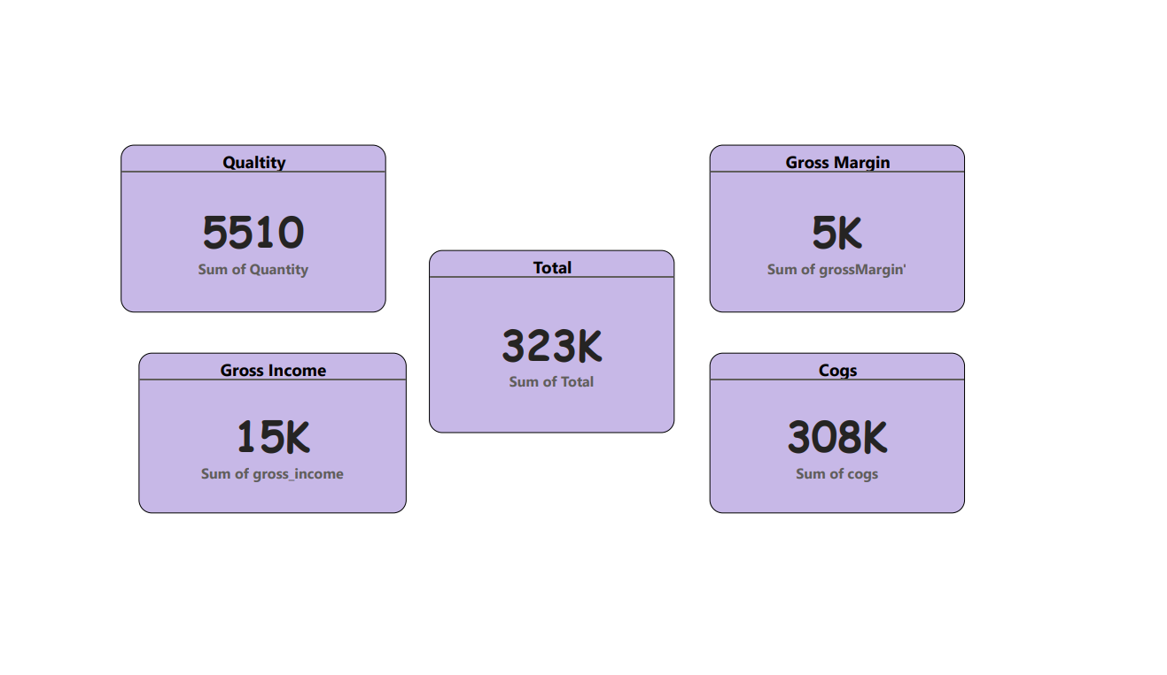
Key Performance Indicators (KPIs) Overview
Total sales amounted to 323K.
A total of 5510 units sold across all product lines.
Walmart generated 15K in gross income.
The gross margin stands at 5K, indicating a healthy profit margin.
The total cost of goods sold (COGS) is 308K, contributing to profitability calculations.

Slide 3
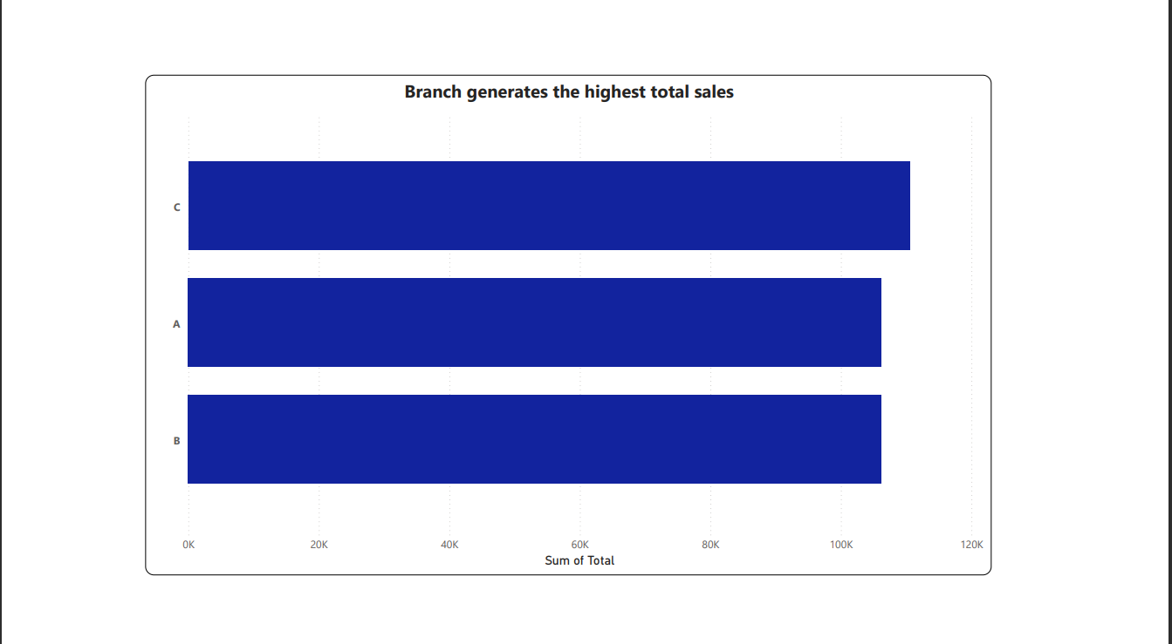
Branch Performance
Branches:
Branch C generated the highest total sales at 120K.
Branch A follows closely with 100K in total sales.
Branch B had the lowest performance, with 80K in total sales.

Slide 4
Top-Selling Product Lines
Product Line Breakdown:
Electronic Accessories: 17.09% of total sales (56.14K).
Food and Beverages: 16.78% of total sales (55.12K).
Health and Beauty: 16.4% of total sales (53.86K).
Fashion Accessories: 14.98% of total sales (49.19K).
Action Points:
Continue focusing on Electronic Accessories and Food and Beverages as they generate the most sales.
Explore opportunities to further promote Fashion Accessories and Sports and Travel.

Slide 5



Customer Demographics and Behavior
City by Gender:
Gender breakdown: Males and females are equally distributed, with minor differences across cities.
Analyze customer preferences by gender to tailor marketing and promotions.
Payment Methods:
Cash is the most commonly used payment method (34.74% of sales).
Ewallet follows closely with 34.06%, indicating a shift toward digital payments.
Credit Card usage is slightly lower at 31.2%.
Recommendation: Encourage more digital payment adoption by offering incentives.

Slide 6
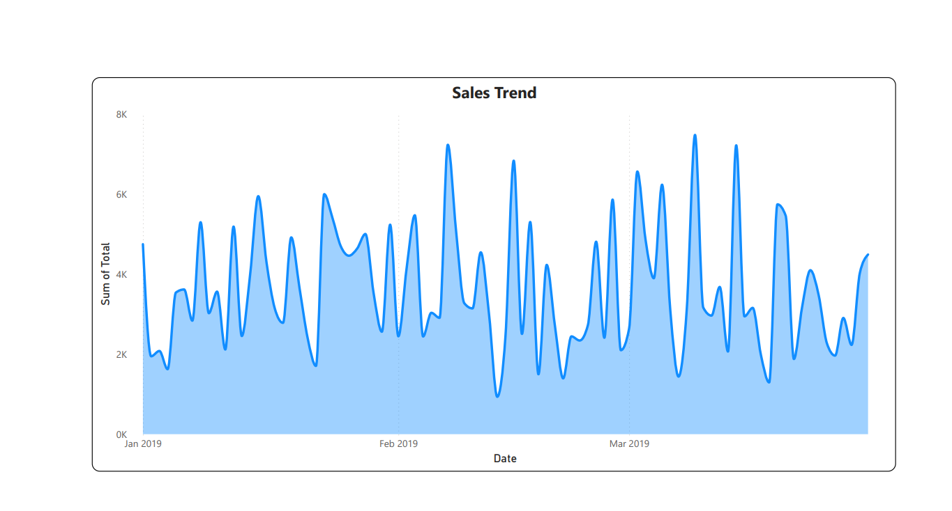
Sales Trend Over Time
Sales Trend:
There’s a noticeable sales spike in March 2019, indicating a seasonal peak or promotional effect.
Sales in January and February are comparatively lower.
Next Steps:
Analyze what drove the sales increase in March and leverage that in future campaigns.
Develop strategies to boost sales during slower months (January and February).

Slide 7
Recommendations for Business Growth
Branch Strategy: Replicate the success of Branch C and analyze Branch B’s weaknesses.
Product Line Optimization: Continue investing in top product lines, while boosting promotions for lower-performing categories.
Customer Segmentation: Utilize customer demographics data to better target promotional offers.
Payment Method Incentives: Encourage digital payments by offering exclusive discounts for Ewallet or Credit Card users.
Seasonal Promotions: Create marketing campaigns to increase sales during traditionally low-sales months.

